Slide 1
Project Name: E-Commerce Dashboard
Team Members:
Yousef Ahmed Mohamed(Team Leader)
Nayra Mahmoud Gabr
Mennatallah Mohamed Hussein
Eslam Ragab Kamal

Slide 2
Agenda
Objectives
Data Transformation
Building Relationships
Building Metrics
Data Visualization
Forecasting for Upcoming 6 Months
Data Insights

Slide 3
Objectives
Unlocking Growth: Analyzing E-Commerce Success Factors Through Data-Driven Insights for Strategic Recommendations on Olist's Platform Performance
Identify Growth Patterns: Analyze data to uncover trends and patterns that drive revenue growth in Olist's e-commerce platform.
Optimize Product Offerings: Evaluate product categories and sales performance to enhance inventory and marketing strategies.
Enhance Seller Performance: Assess seller ratings and performance metrics to improve seller support and retention.
Boost Customer Loyalty: Measure repeat purchase rates to develop strategies that increase customer retention.
Improve Marketing Efficiency: Analyze the effectiveness of marketing expenditures to optimize return on investment.
Leverage Data Insights: Use data-driven insights to guide strategic decisions and enhance overall business performance.

Slide 4
Objectives
Business Analytics Questions 💡
We have crafted fifteen Business Analytics Questions:
1- What is the total revenue generated by Olist, and how has it trended over a period of time? 2- How does the number of orders placed on Olist vary on a monthly or seasonal basis? 3- What product categories are the most popular on Olist, and how do their sales compare to each other? 4- How does the average order value (AOV) on Olist vary based on product category or payment method? 5- How many active sellers are currently operating on Olist, and how has this number changed over time? 6- What is the distribution of seller ratings on Olist, and how does this impact sales performance? 7- How many customers engage in repeat purchases on Olist, and what percentage of total sales do they contribute? 8- What is the average customer rating for products on Olist, and how does it correlate with sales? 9- How does the average order cancellation rate on Olist affect seller performance? 10- What are the top-selling products on Olist, and how have their sales trends evolved over time? 11- What payment methods do Olist customers commonly use, and how does this usage differ by product category or geographic region? 12- How do customer reviews and ratings influence sales and product performance on Olist? 13- Which product categories yield the highest profit margins, and how can profitability within these categories be enhanced? 14- How does Olist's marketing expenditure and channel mix impact sales and customer acquisition costs, and how can the marketing strategy be optimized for improved ROI? 15- Conduct an analysis of customer retention rates based on geolocations with high customer density.

Slide 5
Data Transformation
Data transformation in Power BI involves modifying and cleaning data to prepare it for analysis.
Data Cleaning: Removing duplicates, errors, and inconsistencies to enhance data quality.
Data Shaping: Altering data structures, such as pivoting or unpivoting tables, to facilitate analysis.
Data Merging: Combining multiple tables using joins to create a comprehensive dataset for reporting.
Data Filtering: Applying conditions to focus on specific data subsets relevant to analysis.
Calculated Columns and Measures: Creating new columns or metrics to derive insights directly within Power BI.
These transformations ensure that data is accurate, relevant, and ready for insightful analysis.

Slide 6
Building relationships
A relationship in Power BI simply defines how different tables are related to one
another.
There are a few characteristics of relationships that you should be aware of, which will be discussed in this section:
• Auto-detected relationships
• There may be only one active relationship between two tables
• There may be an unlimited number of inactive relationships between two tables
• Relationships may only be built on a single column, not multiple columns
• Relationships automatically filter from the one side of the relationship to the many side

Slide 7
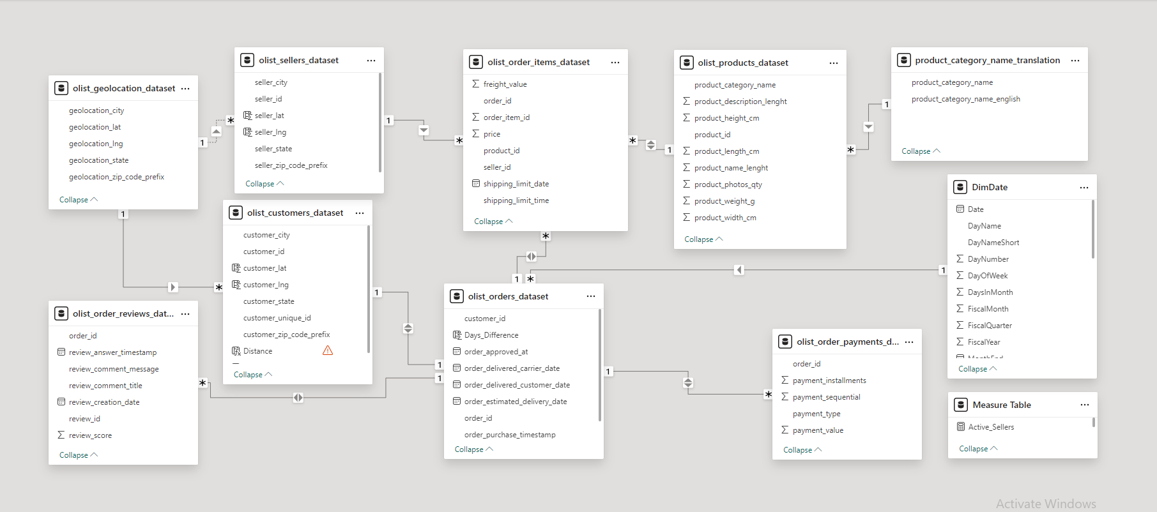
Building relationships

Slide 8
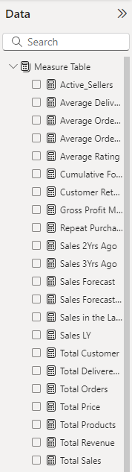
Building Metrics
Building metrics in Power BI involves creating calculations that provide insights into data.
Measures vs. Calculated Columns: Measures are dynamic calculations, while calculated columns are static and stored in the data model.
DAX Language: Metrics are created using DAX (Data Analysis Expressions), a powerful formula language designed for data analysis.
Context Awareness: Metrics respond to filters and slicers, adapting based on the current data context in reports.
Aggregation Types: Metrics can utilize various aggregation functions, such as SUM, AVERAGE, COUNT, and more, to summarize data.
Reusability: Once created, metrics can be reused across multiple reports and visualizations, enhancing consistency and efficiency.

Slide 9
Data Visualization
Data visualizations come in various forms, including charts, graphs, tables, and maps, each serving different purposes for conveying information effectively.
Design Principles: Effective visualizations adhere to design principles such as simplicity, clarity, and consistency, ensuring that viewers can easily interpret the data being presented.
Color Theory: The use of color in visualizations is critical; it can highlight trends, distinguish categories, and evoke emotions, but it should be used thoughtfully to avoid confusion.
Interactivity: Interactive visualizations allow users to engage with the data through filters, tooltips, and drill-down capabilities, enabling deeper insights and exploration.
Storytelling: Data visualization is a powerful storytelling tool. It helps to convey a narrative by combining data with context, making complex information more accessible and memorable.

Slide 10
Forecasting for Upcoming 6 Months
Data Insights

Slide 11

Any Questions ?

Slide 12
Thank You ♥♥

